Slide 1
Atomic Model
By Anastasia Mikeladze

Slide 2
Research and calculations
Before actually creating the model, I must first do calculations about the size of protons, neutrons, and electrons so the size of my model can be as relative as possible to an actual atom. Also please keep in mind that since it is very hard to measure the actual sizes of protons, neutrons, and electrons, all of these are just estimations.
Proton: 0.84×10⁻¹⁵ fm
Neutron: 0.8×10⁻¹⁵ fm
Electron: 2.8179×10⁻¹⁵ fm
(All of this information was taken from Wikipedia).
Now, to convert this to centimeters.
Proton: 0.84x10^-15 fm x 10^16 = 8.4 cm
Neutron: 0.8x^10-15 fm x 10^16 = 8 cm
Electron: 2.8179x10^-15 fm x 10^16 = 2.8179 cm

Slide 3
Materials
Colored clay
Skewers
Tape
Scissors
Aluminum foil
I chose these materials because I felt that they would be the easiest to work with. The clay is easy to shape into balls, the skewers are sturdy so I know that it won’t fall apart, and I used the aluminum foil because it was easy to make it into the shape I wanted it to be. The tape was to hold the aluminum foil together and for extra security.

Slide 4
procedure
Since I’m making a hydrogen atom, I need one proton, and one electron. I chose red for the proton and yellow for the electron.
I first started with the proton and electron. Since I didn’t have enough clay to make the diameter 8.4 centimeters, I divided both 8.4 and 2 by 4 and got 2.1 cm for the proton, and 0.5 centimeters for the electron.
After I made the proton and electron, I connected them using a wooden skewer.
Although they aren’t actually visible, I also made orbital rings for the atom to demonstrate how they work. I made them by cutting off a long piece of aluminum and rolling it up. Since one piece was too short, I made two and connected them with tape before connecting them with the electron. I repeated this process three times.

Slide 5
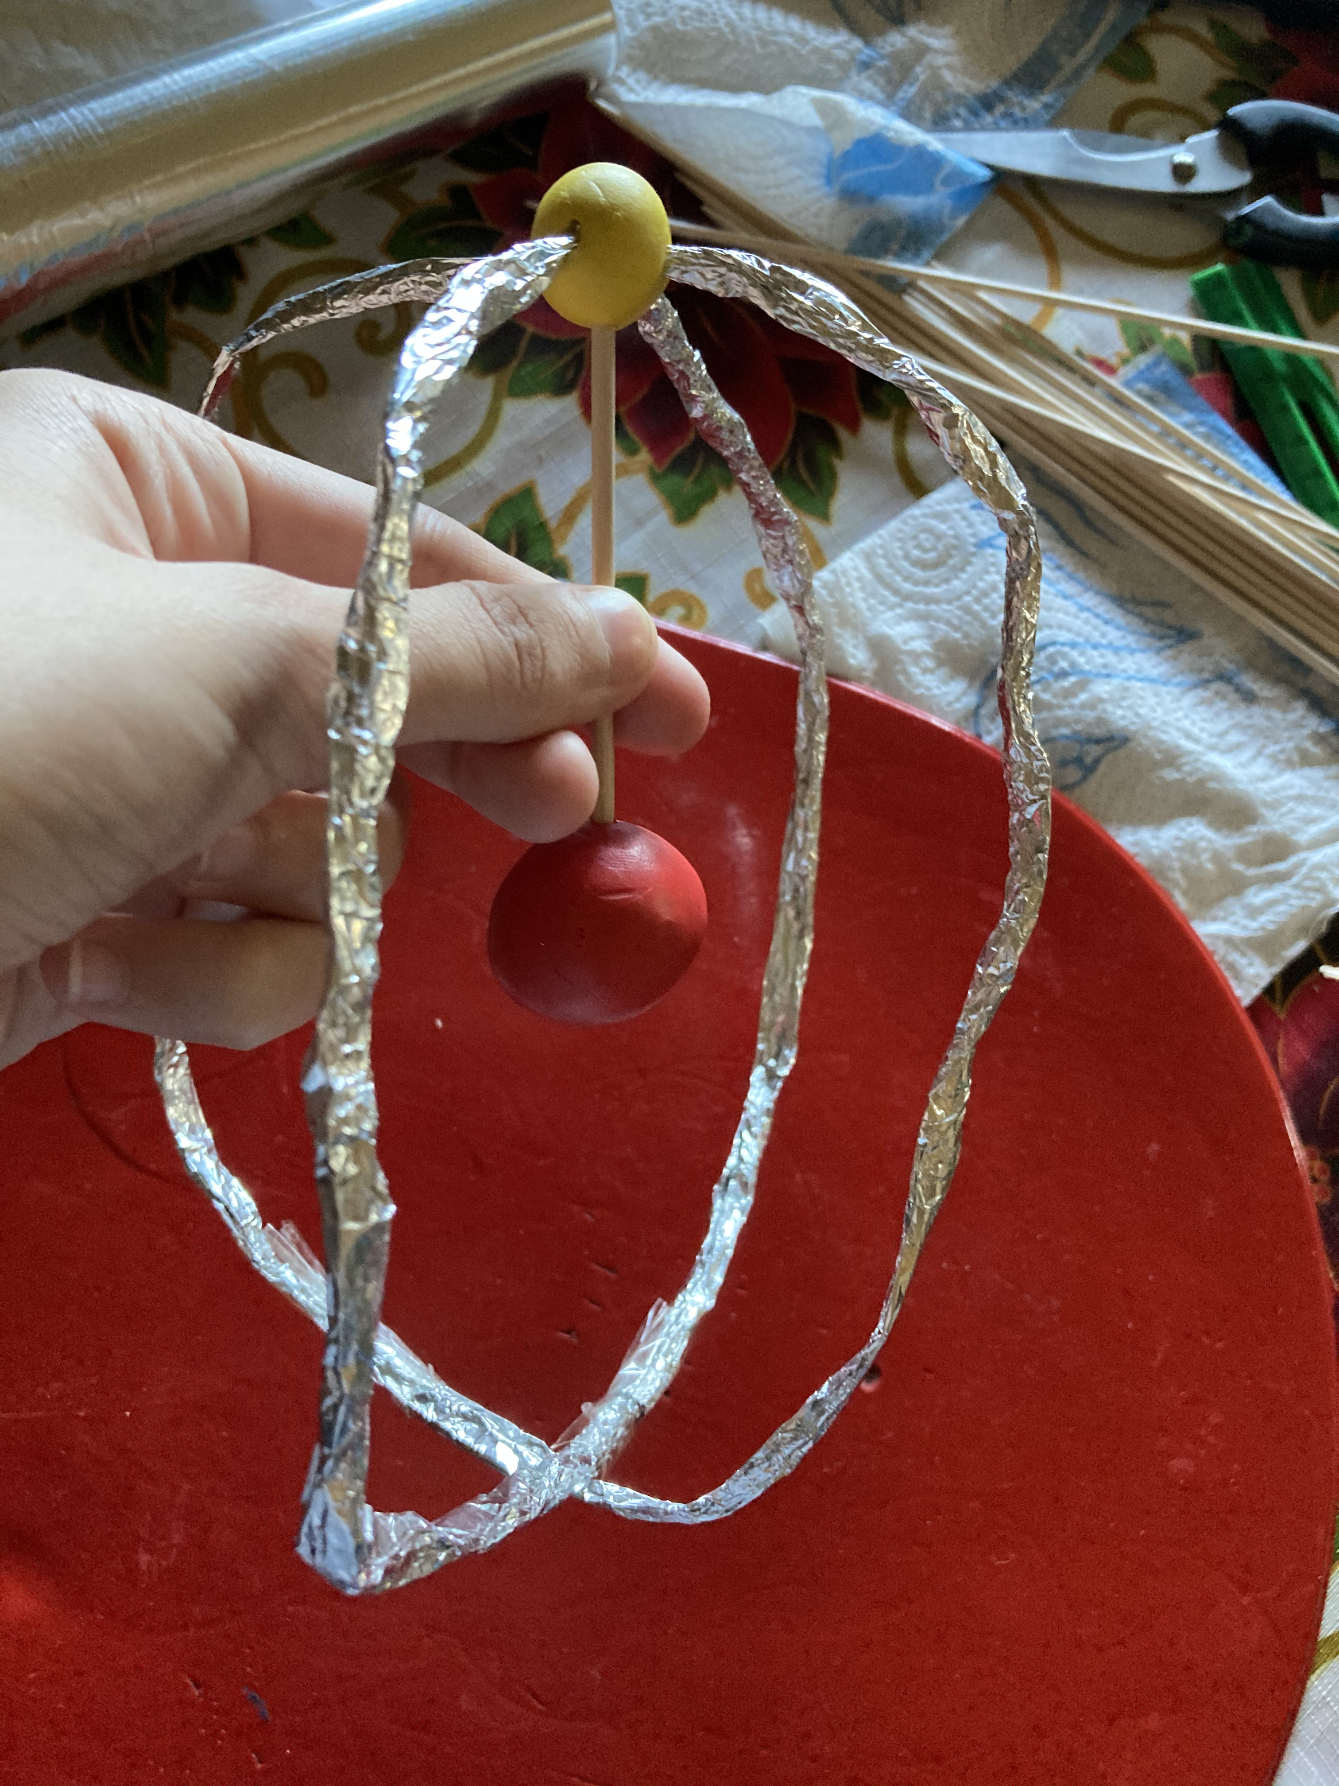
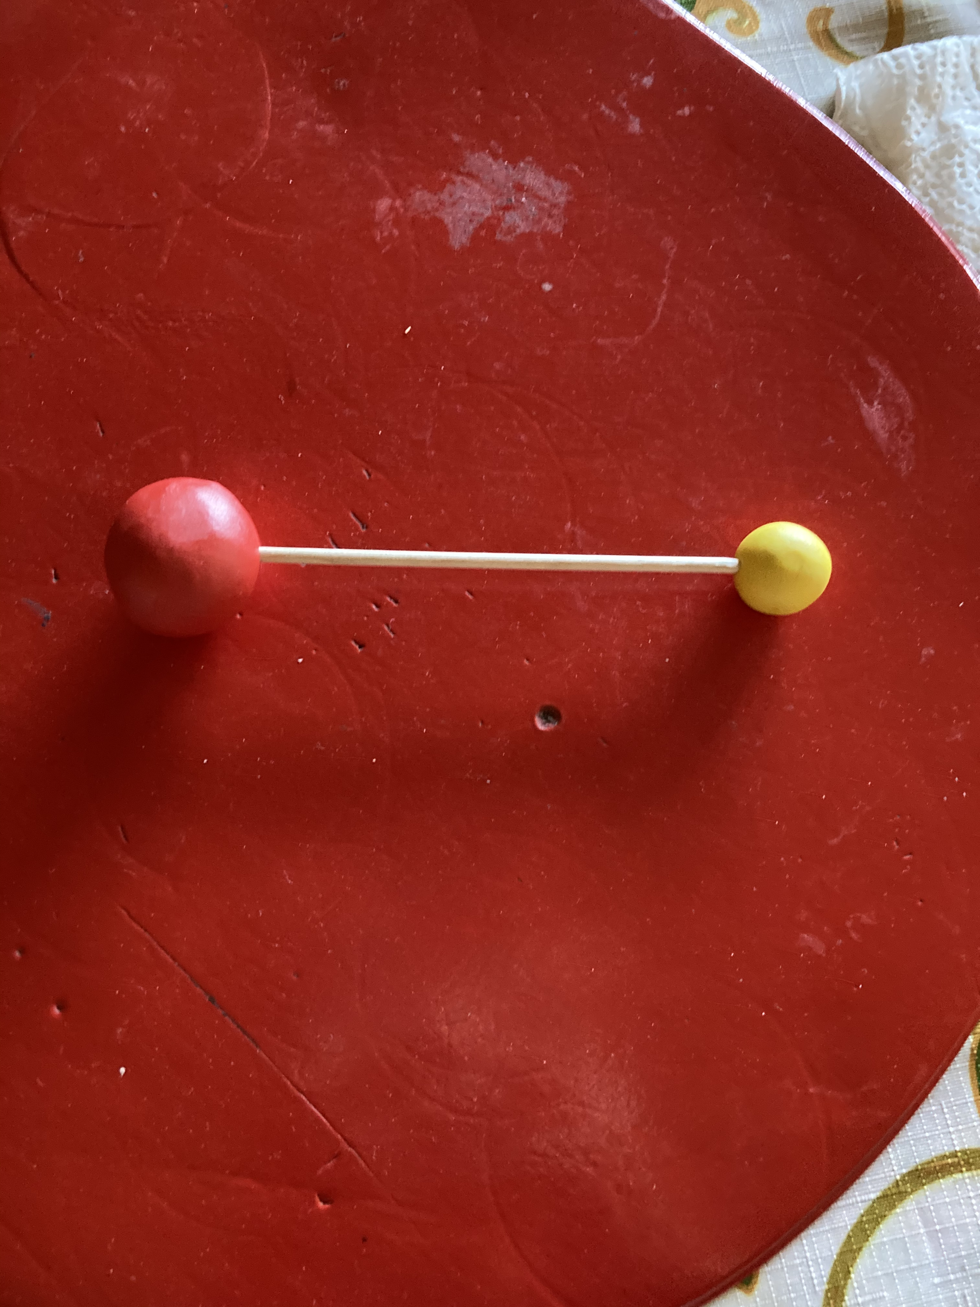
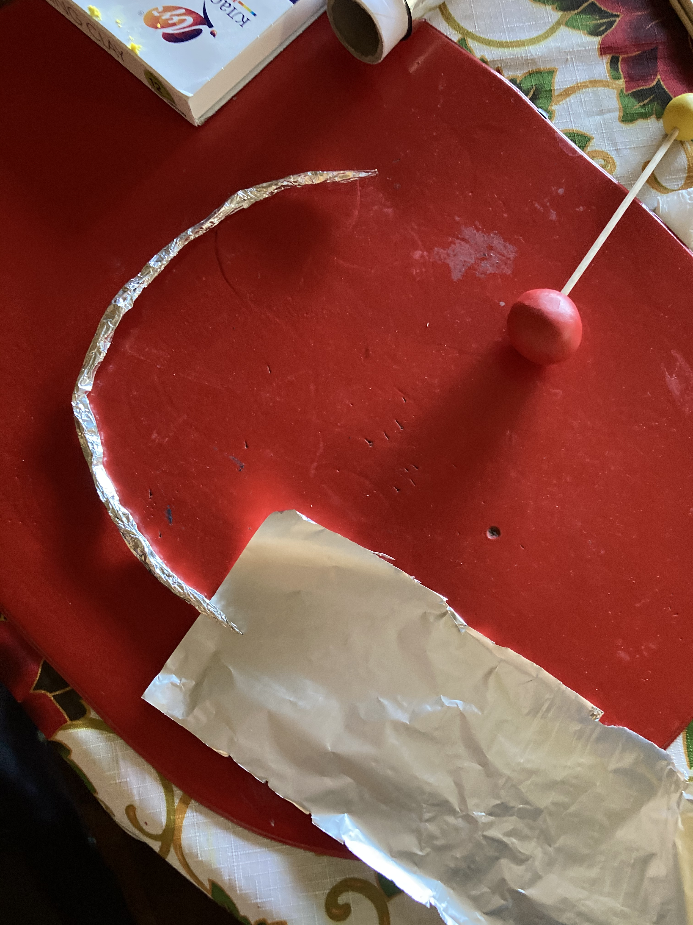
Pictures of the process

Slide 6
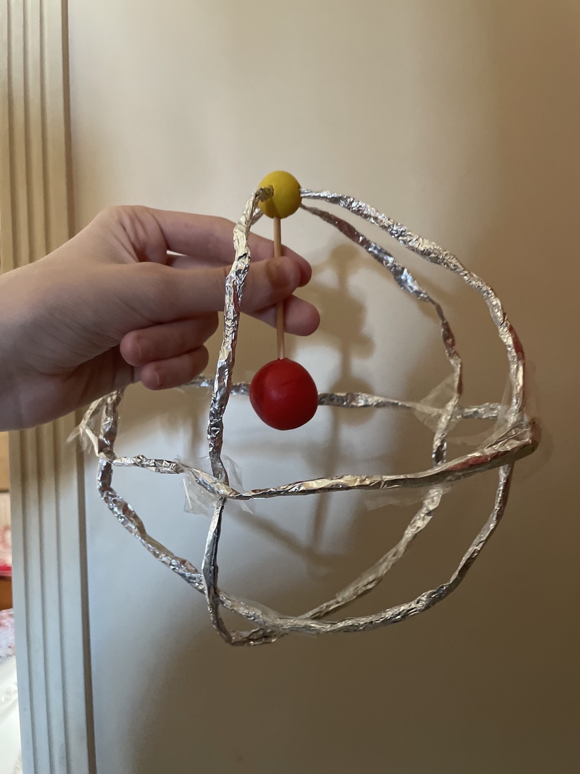
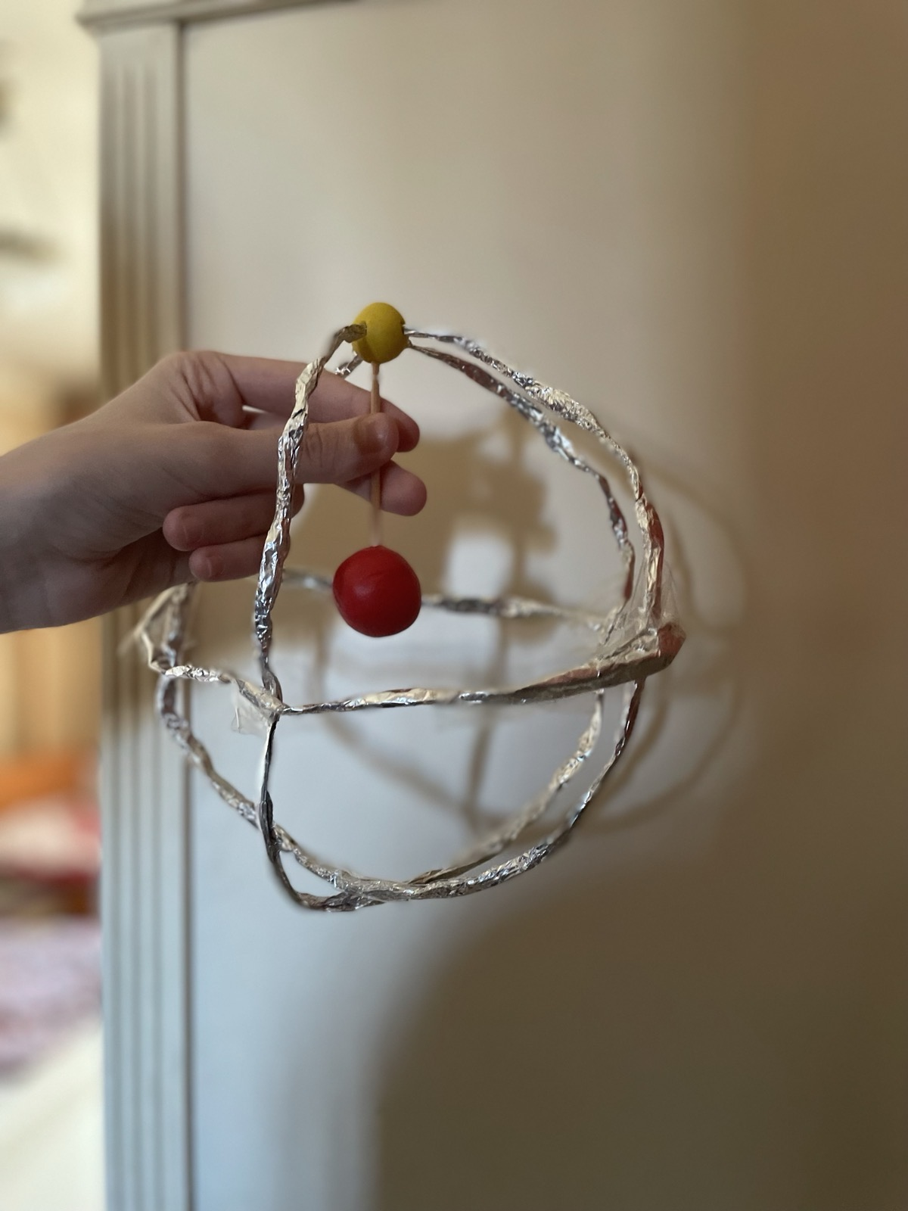
Final result

Slide 7
inaccuracies
It would be very difficult to create a realistic model of an atom, so I will list the inaccuracies that my model has:
For starters, the distance between the proton and the electron would be a lot bigger once converted to centimeters. The distance between a nucleus and an electron is 5.29x10^-11. So I did 0.0000000000529x10^12 to figure out the distance in meters and got 52.9. That would be 5,290 cm while the distance in my model is only about 6 cm.
Another inaccuracy in my model is that electrons aren’t solid balls, but instead are spread out. The best way I can describe them is that they sort of act like particles, although that isn’t completely accurate either. It would be difficult for me to recreate an actual electron in real life, so I had to make it ball-shaped instead.
Protons are also around 1,835 bigger than electrons, so making a protons that’s 1,835 times bigger than an electron would be impossible for me. That’s another factor in my model that isn’t accurate.

